Slide 1
Report On Determination of The Contents of Cold Drinks
PRESENTED By:
Md. Shahin Shariour Shaishab
Roll: 01-023-09

Slide 2
Table of Contents
Introduction
Theory
Apparatus
Chemicals Required
Detection of pH
Test for Carbon Dioxide
Test for Glucose
Test for Phosphate
Test for Alcohol
Test for Sucrose
Result
Conclusion

Slide 3
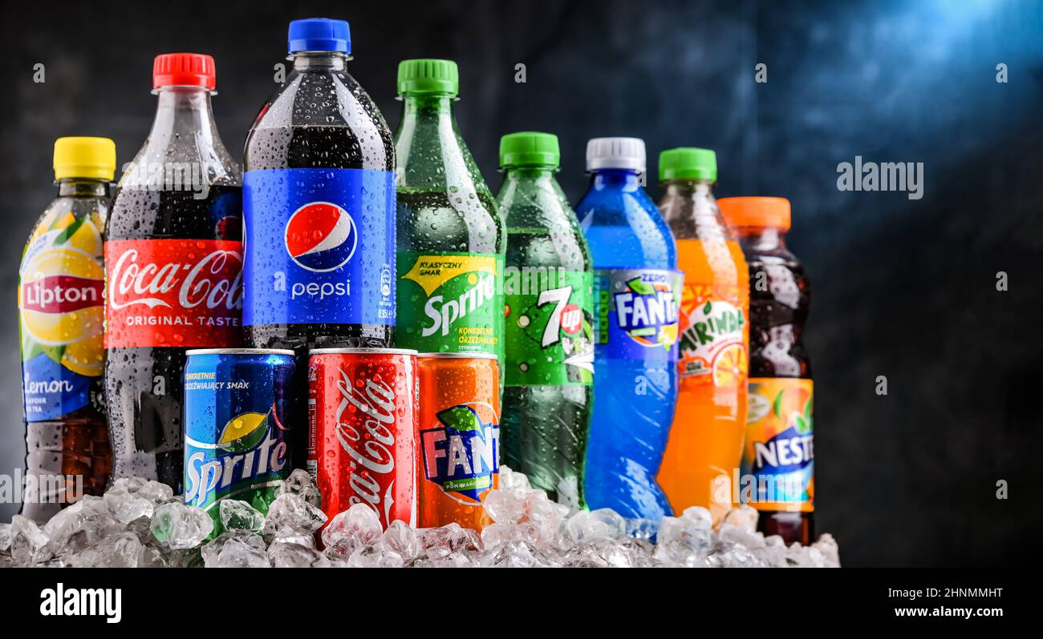
INTRODUCTION
The era of cold drinks began in 1952 but the industrialization in India marked its beginning with launching of Limca and Goldspot by parley group of companies. Since, the beginning of cold drinks was highly profitable and luring, many multinational companies launched their brands in India like Pepsi and Coke.
Now days, it is observed in general that majority of people viewed Sprite, Miranda, and Limca to give feeling of lightness, while Pepsi and Thumps Up to activate pulse and brain.

Slide 4
Theory
Cold drinks of different brands are composed of alcohol, carbohydrates, carbon dioxide, phosphate ions etc. These soft drinks give feeling of warmth, lightness and have a tangy taste which is liked by everyone. Carbon dioxide is responsible for the formation of froth on shaking the bottle.
The carbon dioxide gas is dissolved in water to form carbonic acid which is also responsible for the tangy taste. Carbohydrates are the naturally occurring organic compounds and are major source of energy to our body. General formula of carbohydrates is
C_{X} (H₂O)_{Y}
On the basis of their molecule size carbohydrates are classified as:-
Monosaccharide, Disaccharides and Polysaccharides. Glucose is a monosaccharide with formula C₆H₁₂O₆ .It occurs in Free State in the ripen grapes in bones and also in many sweet fruits. It is also present in human blood to the extent of about 0.1%. Sucrose is one of the most useful disaccharides in our daily life. It is widely distributed in nature in juices, seeds and also in flowers of many plants. The main source of sucrose is sugar cane juice which contain 15-20 % sucrose and sugar beet which has about 10-17 % sucrose. The molecular formula of sucrose is C₁₂H₂₂O₁₁. It is produced by a mixture of glucose and fructose. It is non-reducing in nature whereas glucose is reducing. Cold drinks are a bit acidic in nature and their acidity can be measured by finding their pH value. The pH values also depend upon the acidic contents such as citric acid and phosphoric acid.

Slide 5
Apparatus
Test Tube
Test Tube Holder
Test Tube Stand
Stop Watch
Beaker
Burner
pH Paper
Tripod Stand
China Dish
Wire Gauge
Water Bath

Slide 6
Chemicals Required
Iodine Solution
Potassium Iodine
Sodium Hydroxide
Fehling’s A & B Solution
Lime Water
Concentrated HNO3
Benedict Solution
Ammonium Molybdate

Slide 7
Soft Drink Industry Market
Global Scenario
Globally, carbonated soft drinks are third most consumed beverages.
Per capita annual consumption of carbonated.
Soft drinks is nearly four times the per capita consumption of fruit beverages .
Soft drink consumption is growing by around 5% a year, accordingto the publication Global Soft drinks 2002.
Total volume reached 412,000 million litres in 2001, giving aglobal per capita consumption of around 67.5 litres per year.

Slide 8
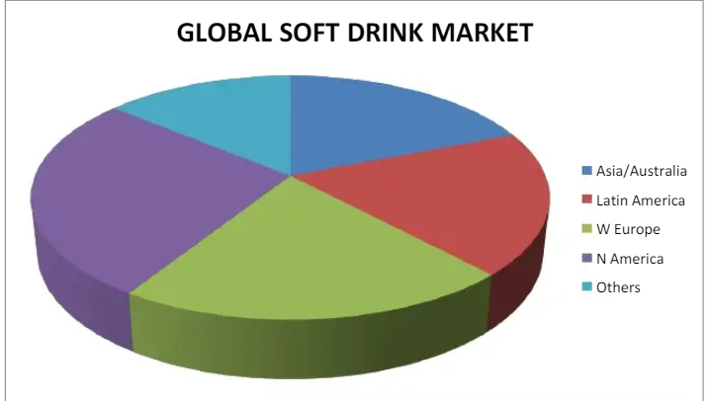
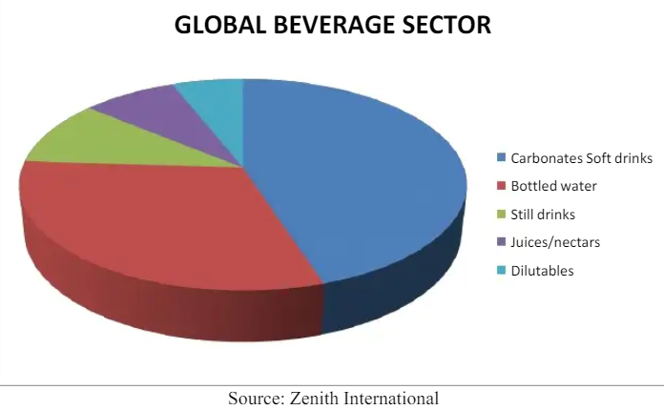

Slide 9
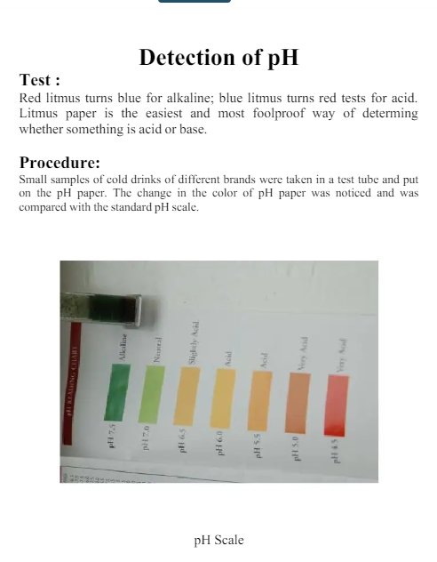

Slide 10
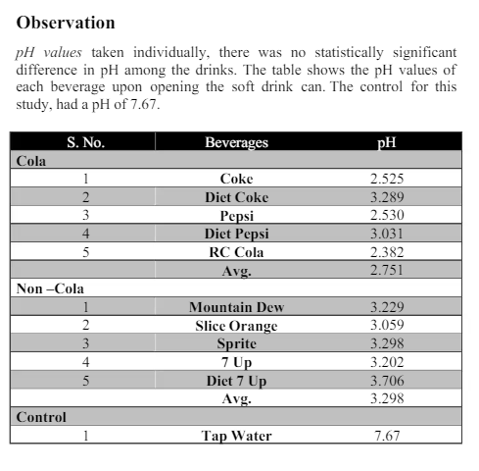

Slide 11
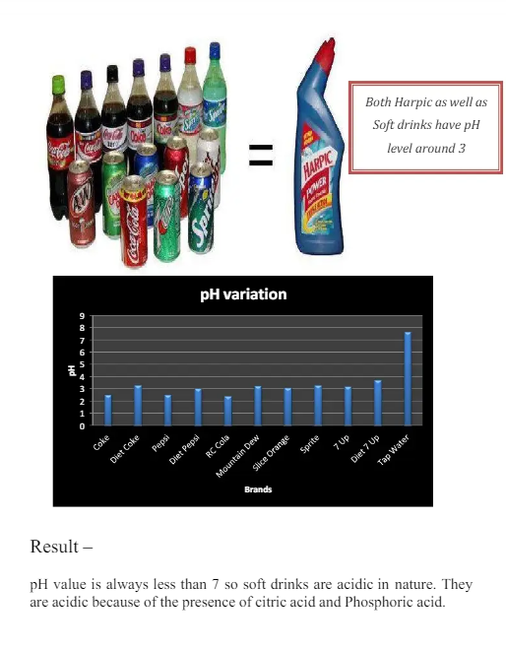

Slide 12
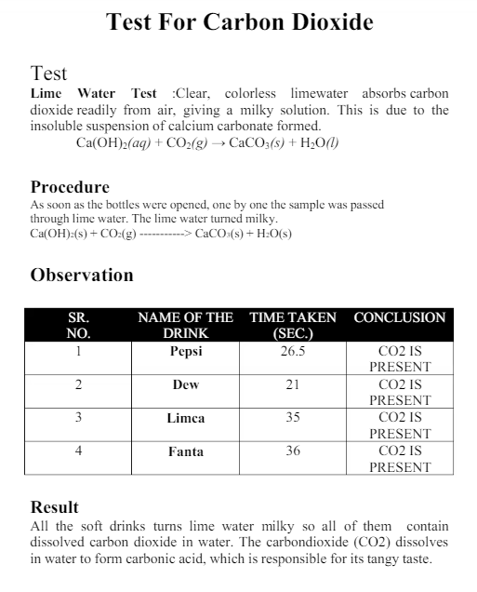

Slide 13
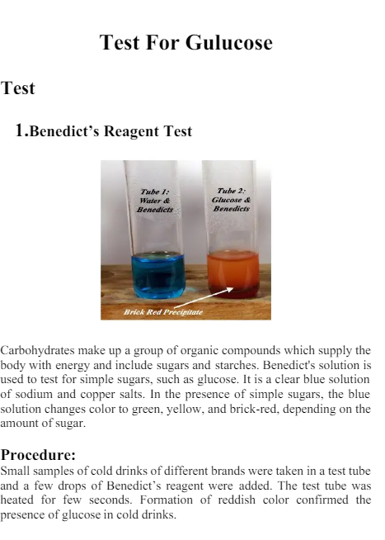

Slide 14
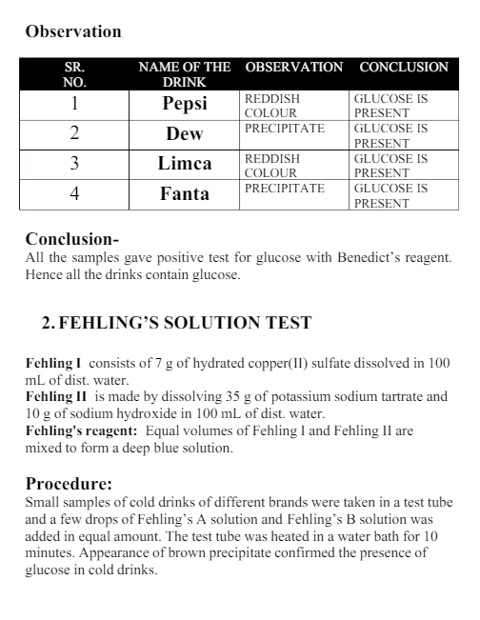

Slide 15
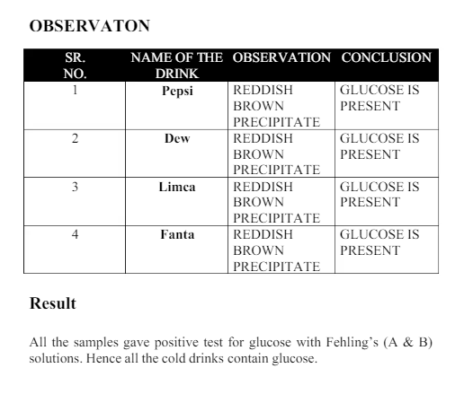

Slide 16
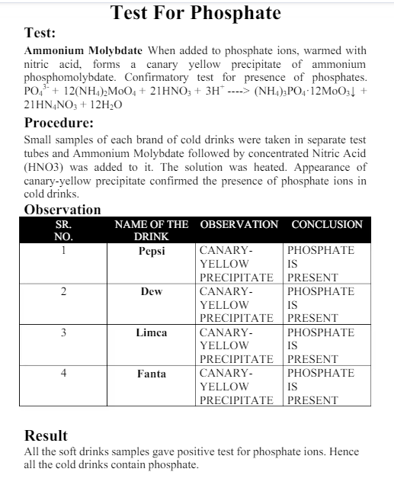

Slide 17
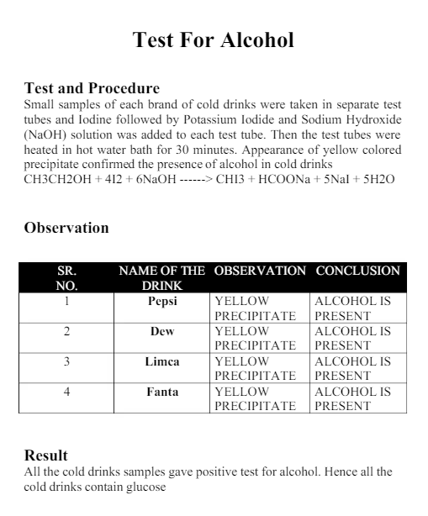

Slide 18
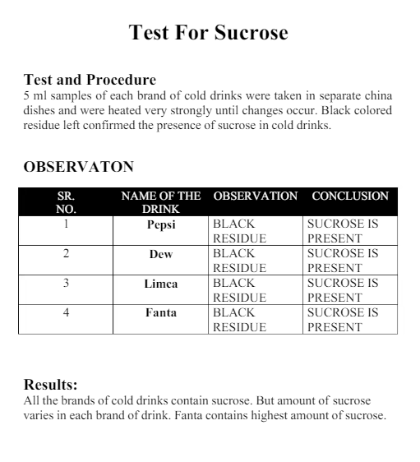

Slide 19
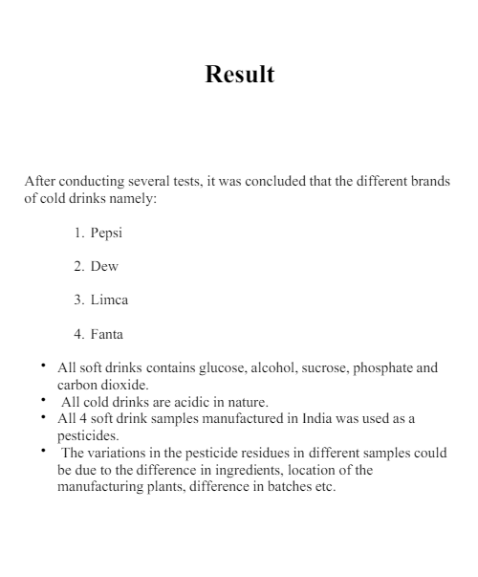

Slide 20
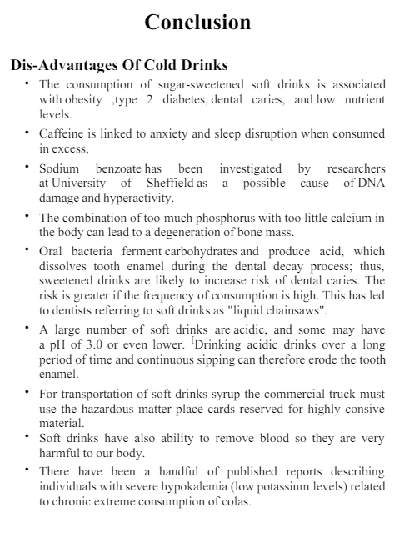

Slide 21
